Slide 1

language in human evolution
By: negar

Slide 2
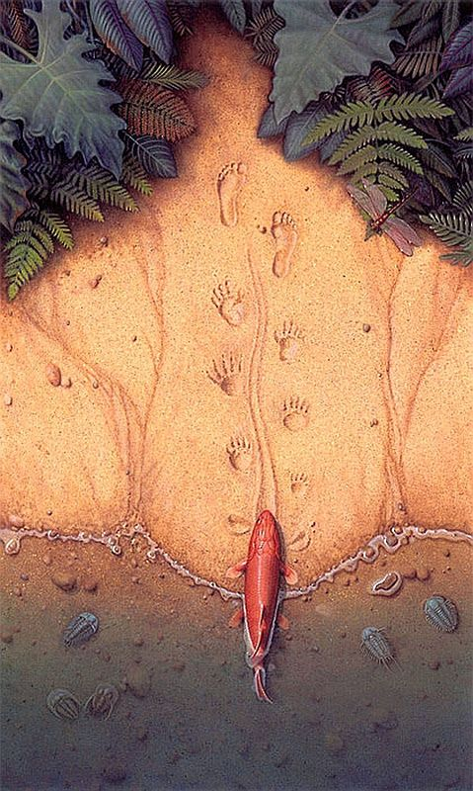
Cognitive Development
Abstract Thinking:
Enabled complex thought processes and problem-solving.
Memory and Knowledge Transmission:
Facilitated the accumulation and sharing of knowledge across generations.

Slide 3

Social Evolution
Coordination and Cooperation:
Improved group activities and collective strategies.
Social Bonds and Group Identity:
Strengthened social networks and community cohesion.

Slide 4

Cultural Evolution
Cultural Transmission:
Preserved customs, traditions, and beliefs.
Art and Science Development:
Supported the creation of literature, art, and scientific inquiry.

Slide 5

Key Milestones
Gesture and Vocalization:
Early forms of communication evolved into more complex systems.
Development of Syntax:
Allowed for detailed and nuanced communication.
Written Language:
Enabled the documentation and dissemination of knowledge, supporting complex societies.

Slide 6
Thank you

